Slide 1

Google Play Store
App Popularity Analysis
Erdal Terkivatan

Slide 2
The Problem
What are the factors that affect app rating?

Slide 3
The Data
Model Variables
Target Variable: Rating
Category (Genres)
App Size
App Type (Free vs. Paid)
Number of Installs
Number of reviews
Age group that rated the app
App name

Slide 4
Data Wrangling
Activities performed on the data
Data type conversion
Drop irrelevant columns such as current version, android version.
Remove all non-ASCII characters in the data
Apply appropriate filling method to null values
Detect duplicates

Slide 5
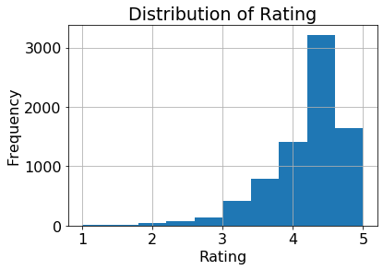
Exploratory Data Analysis
The rating variable has left-skewed data due to the small values (2 or below)

Slide 6
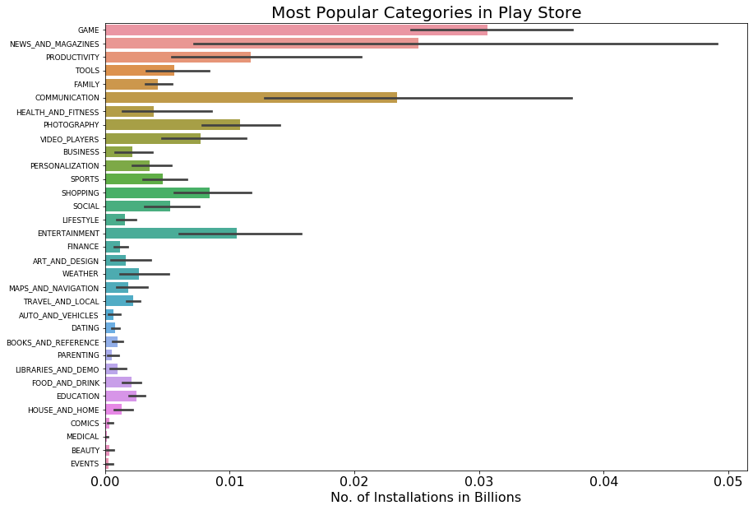
Most Popular Category (Based on Installs)
Apps in game category has the maximum number of installs

Slide 7
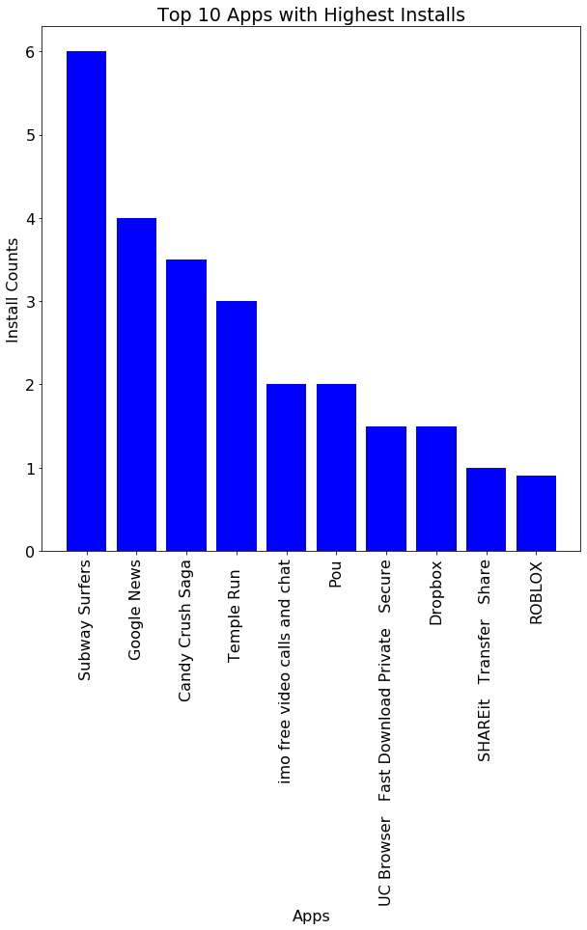
Top 10 Apps installed most
“Subway Surfers” is installed most of the time followed by “Google News” and “Candy Crash Saga”

Slide 8
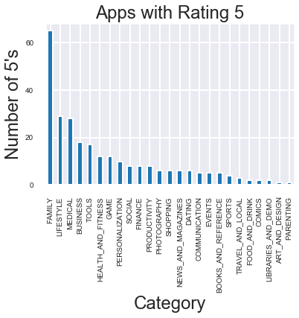
What Category is rated as 5 most?
“Family” category rated 5 most of the time.

Slide 9
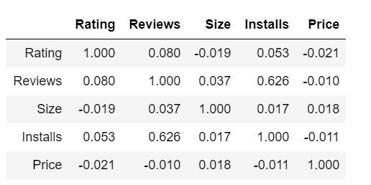
Correlation Analysis
Almost no correlation between rating and the other variables
“Installs” and “ Reviews” are moderately positively correlated

Slide 10
Model Selection
Models
Random Forest Regression
Linear Regression
Decision Tree Regression

Slide 11
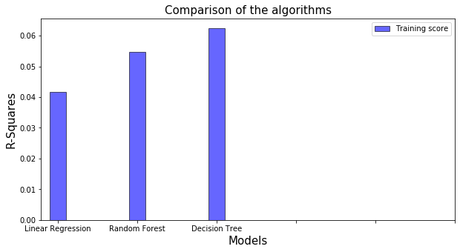
Performance Comparison
Linear Regression has the lowest R-square
Decision tree performs the best

Slide 12
Hyperparameter Tuning
Applied hyperparameter tuning on decision tree regression algorithm
The R-square increased from 6.3% to 6.7%

Slide 13
Conclusions
None of the algorithms performed well .
The highest R-square achieved by decision tree algorithm is 6.7%
The reason for poor performance: The variables included in the model are almost not correlated with the response variable

Slide 14
Suggestion
Consider different explanatory variables

